Slide 1
FORECASTING HEART PROBLEMS BY IMPLEMENTING MACHINE LEARNING ALGORITHMS.
7007429050 - Mareedu Sai Sritha 700742428 - Rishitha Reddy
700734096 - Nandini Ramshetty
700741157 - Sai Sumanth Kolanupaka

Slide 2
1.Responsibilities and Contribution in Project
TASKS COMPLETED
Action Plan | Team Member | Contribution
Collected and analyzed the data. | Sai Sumanth Kolanupaka | 23%
Prioritized the problems andidentified solutions. | Nallakalava Rishitha | 23%
Developed the code and done the documentation. | Mareedu Sai Sritha | 31%
Tested the classified model and collectedreference papers. | Nandini Ramshetty | 23%

Slide 3
2. MOTIVATION:
The main motivation of doing this project is to present a heart disease prediction model for the prediction of occurrence of heart disease. Furthermore, this research is aimed at identifying the best algorithm for identifying patients at risk for heart disease. This work is justified by performing a comparative study and analysis using four classification algorithms namely knn, Decision Tree, Support vector and Random Forest are used at different levels of evaluations.

Slide 4
3.OBJECTIVES:
Machine learning is used to discover patterns from the user data and then make predictions based on trained data. ML helps in analyzing the data and identifying trends.
The objective of this project is to check whether the patient is likely to be diagnosed with any cardiovascular heart diseases based on their medical attributes such as gender, age, chest pain, sugar level, etc.

Slide 5
4. RELATED WORK:
After studying few ieee papers we came to know that by using ML algorithms the accuracy is between 80-85%.
Those are : Support vector machine = 82%
Decision tree = 79%
KNN = 84%
Whereas, By applying hybrid algorithms they have obtained 88.4%.

Slide 6
5. PROBLEM STATEMENT:
Designing the heart disease prediction system using machine learning techniques.
Inorder to obtain greater accuracy.

Slide 7
6. PROPOSED SOLUTION:
We have developed our problem statement using kaggle dataset .
Initially, To analyze the dataset we have plotted correlation matrix. Inorder to check whether the features have negative or positive correlation with the target value.
After that basic operations were done on the dataset including scaling to get better accuracy.

Slide 8
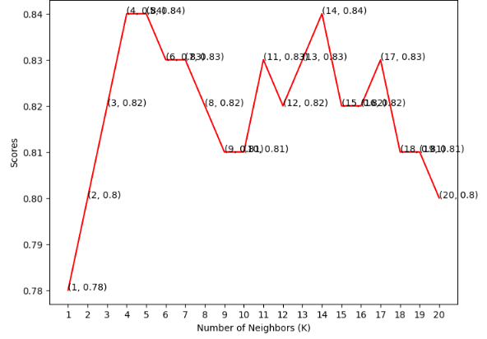
CONTINUED:
4. We have used 4 ML algorithms in our project.
K Neighbours Classifier :
We took range of [1-21]
neighbours and plotted a score graph.
The maximum accuracy was found at
k= 14 with 84.0%.

Slide 9
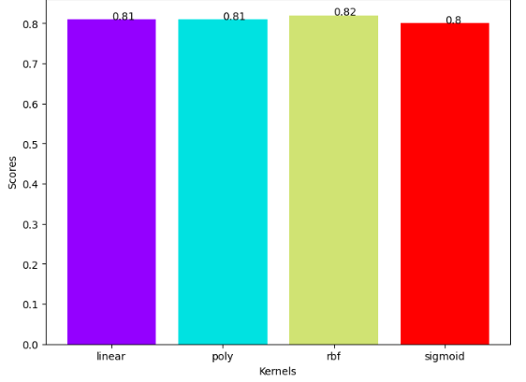
CONTINUED:
b. Support vector classifier :
In this we have taken 4 kernels
linear, poly, rbf, sigmoid. The rbf kernel
performed best.

Slide 10
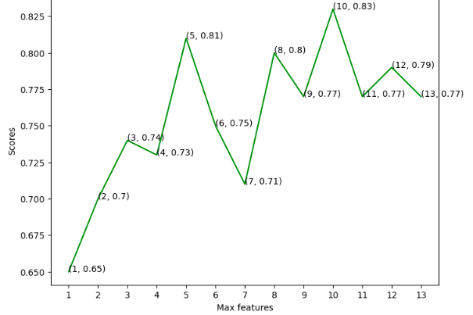
CONTINUED:
c. Decision tree classifier:
Here, we have taken 13 features
and plotted them we found best
accuracy at 2, 4 and 10 features.

Slide 11
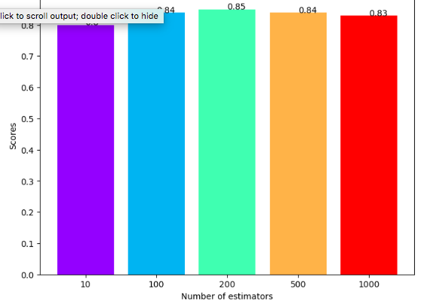
CONTINUED:
d. Random forest classifier:
There are 5 estimators among
them 200 estimator has achieved
best accuracy with 85.0%.

Slide 12
RESULTS:
By using the standard GUI library for python i.e., Tkinter we have developed a GUI.
which takes the patients data(age, sex, cp,trestbps,chol,fbs, restecg, oldpeak, ca, slope, exang, thalach) as input and gives out the prediction.

Slide 13
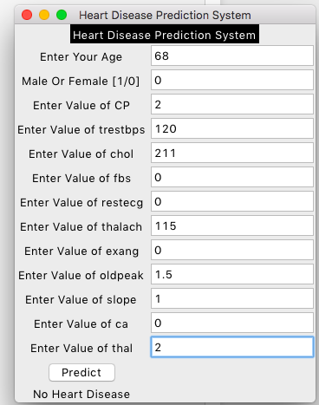
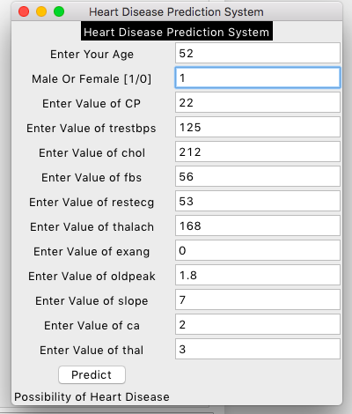
CONTINUED:

Slide 14
REFERENCES:
V. Sharma, S. Yadav and M. Gupta, "Heart Disease Prediction using Machine Learning Techniques," 2020 2nd International Conference on Advances in Computing, Communication Control and Networking (ICACCCN), 2020, pp. 177-181, doi: 10.1109/ICACCCN51052.2020.9362842.
H. Singh, T. Gupta and J. Sidhu, "Prediction of Heart Disease using Machine Learning Techniques," 2021 Sixth International Conference on Image Information Processing (ICIIP), 2021, pp. 164-169, doi: 10.1109/ICIIP53038.2021.9702625.
A. Gavhane, G. Kokkula, I. Pandya and K. Devadkar, "Prediction of Heart Disease Using Machine Learning," 2018 Second International Conference on Electronics, Communication and Aerospace Technology (ICECA), 2018, pp. 1275-1278, doi: 10.1109/ICECA.2018.8474922.
Senthilkumar Mohan Chandrasegar Thirumalai and Gautam Srivastava "Effective heart disease prediction using hybrid machine learning techniques" IEEE Access vol. 7 no. 2019 pp. 81542-81554.
A. Singh and R. Kumar "Heart Disease Prediction Using Machine Learning Algorithms”. 2020 International Conference on E. “Ali Liaqat” An optimized stacked support vector machines based expert system for the effective prediction of heart failure" IEEE Access vol. 7 no. 2019 pp. 54007-54014 2010.
D. Baroud A. N. Hasan and T. Shongwe "A study towards implementing various artificial neural networks for signal classification and noise detection in PFDM/PLC Channels" 12th IEEE international symposium on communication systems networks and digital signal processing (CSNDSP) 2020.

